Slide 1

Explaining Emotion-Belief Expressions of Advocacy Coalitions in Arkansas’ Gender Identity Politics
Allegra H. Fullerton & Chris Weible
Presentation prepared for the
Korbel Research Seminar | University of Denver
May 25, 2023
Notes:
Intro

Slide 2
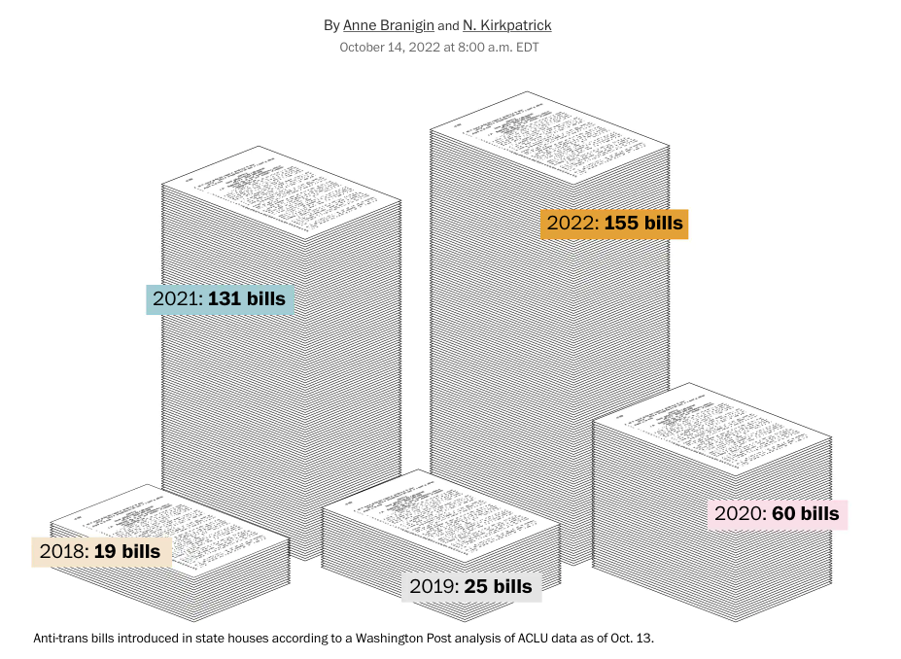
Context: Anti-Trans legislation in the United States
2021 Arkansas HB1570
Save Adolescents from Experimentation (SAFE) Act
One of the first Gender Affirming Care (GAC) bans in the US
Notes:
GAC provides holistic medical care to transgender and gender diverse people and is a medical necessity to help an individual align various aspects of their lives to their gender identity.
Gender identity is a person’s deeply-felt internal sense of being male, female, or another gender, and their gender expressions refer to a person’s characteristics and behaviors, such as appearance or speech patterns, that can be described as masculine, feminine, or something else
Many who seek GAC suffer from gender dysphoria or psychological stress from the incongruence of their gender assignment (sex at or before birth) and identity
The American views on gender identity are complex, with many favoring protecting trans people from discrimination yet fewer support policies related to medical care. Divide is polarized between political parties and often linked with religious beliefs (ties into broader anti-gender and populism literature)
HB1570 highly contested, bill passed, governor vetoed, leg overruled veto, challenged in courts, and now in 2023 a similar bill that cannot be overruled in the court system and adds criminalization for providers is moving through the legislature
Arkansas R trifecta since 2015, leaned R since 2012

Slide 3
Research Questions
To what extent do coalitions manifest through their emotion-belief expressions in debates about Arkansas’s law (HB1570) that bans gender affirming care?
What combinations of emotion-belief expressions associate most strongly with coalition membership and similar positions on HB1570?

Slide 4
Advocacy Coalition Framework (ACF)
Notes:
Coalitions are informal alliances of govt and non govt that advocate for their policy positions

Slide 5
Definitions
Categories of Emotion Expressions in Analysis
anger, careless, dismay, fear, affinity, compassion, trust
Positive = affinity, compassion, trust
Negative = anger, careless, dismay, fear
Emotional expressions = expressions of feeling or affect through language
Discrete emotions = categories of emotions observable in our analysis
Diffuse emotions = positive (liking) and negative (avoidance)

Slide 6
Definitions
Categories of Emotion Expressions in Analysis
anger, careless, dismay, fear, affinity, compassion, trust
Positive = affinity, compassion, trust
Negative = anger, careless, dismay, fear
Emotional expressions = expressions of feeling or affect through language
Discrete emotions = categories of emotions observable in our analysis
Diffuse emotions = positive (liking) and negative (avoidance)

Slide 7
Definitions
Categories of Emotion Expressions in Analysis
anger, careless, dismay, fear, affinity, compassion, trust
Positive = affinity, compassion, trust
Negative = anger, careless, dismay, fear
Emotional expressions = expressions of feeling or affect through language
Discrete emotions = categories of emotions observable in our analysis
Diffuse emotions = positive (liking) and negative (avoidance)

Slide 8
Definitions
Categories of Emotion Expressions in Analysis
anger, careless, dismay, fear, affinity, compassion, trust
Positive = affinity, compassion, trust
Negative = anger, careless, dismay, fear
Emotional expressions = expressions of feeling or affect through language
Discrete emotions = categories of emotions observable in our analysis
Diffuse emotions = positive (liking) and negative (avoidance)
Dyads = expressions that contains an emotion and a belief

Slide 9
Definitions
Categories of Emotion Expressions in Analysis
anger, careless, dismay, fear, affinity, compassion, trust
Positive = affinity, compassion, trust
Negative = anger, careless, dismay, fear
Anger&Bill, Health/SafetyKids&Compassion
Emotional expressions = expressions of feeling or affect through language
Discrete emotions = categories of emotions observable in our analysis
Diffuse emotions = positive (liking) and negative (avoidance)
Dyads = expressions that contains an emotion and a belief

Slide 10
Theoretical Foundations
Hypotheses
Causal driver for (ACF): Policy core beliefs are the primary glue for coalitions; deep core beliefs are fundamental normative beliefs (less sticky for coalitions)
Emotions interrelate with beliefs
Actor (Emotions ⇆ Beliefs)
Negative emotions are more important than positive emotions in group dynamics
H1. Actors will coalesce into distinct coalitions by their emotion-belief expressions
H2. Policy-Core beliefs and negative emotions will show more homophily than expressions involving deep core or positive emotions
H3. Policy core belief and negative emotion expressions will be more important than deep core belief and positive emotion expressions for coalition assignment and policy position
Notes:
Emotions link human behavior, values, beliefs (Goldie, 2012)
Philosophy and Sociology emotions
dramaturgical, cultural, and structural (Turner & Stets 2005)
Emotions can be used as ends and means in political contexts (Clarke, Simon, Hoggert, Thompson 2006)
Emotions can be empirically studied
Emotions and policy process emerging area (Durnová, Pierce, Verhoeven, Yordy, Fullerton, Gabehart, Crawford….)
Human behavior, values, beliefs & belief formation, political behavior, sensemaking, persuasion, mobilization, more…(lots!)
We think that PCB are important, and be measureable through shared discourse
Talk here about ACF
Spend some time –
Repeat coalitions here -

Slide 11
Theoretical Foundations
Hypotheses
Causal driver for (ACF): Policy core beliefs are the primary glue for coalitions; deep core beliefs are fundamental normative beliefs (less sticky for coalitions)
Emotions interrelate with beliefs
Actor (Emotions ⇆ Beliefs)
Negative emotions are more important than positive emotions in group dynamics
H1. Actors will coalesce into distinct coalitions through their emotion-belief expressions
H2. Policy-Core beliefs and negative emotions will show more homophily than expressions involving deep core or positive emotions
H3. Policy core belief and negative emotion expressions will be more important than deep core belief and positive emotion expressions for coalition assignment and policy position
Notes:
Coalitions’ Distinct Emotion-Belief Expression Hypothesis 1. Both coalitions will show distinct emotion-belief expressions and express positive and negative emotional valence and various discrete emotions in their debates consistent with their belief systems
Coalitions’ Homophily Hypothesis 2. Coalitions’ policy core belief dyads will show more homophily than deep core belief dyads, and negative emotion dyads will show more homophily than positive emotion dyads
Belief Affiliation Hypothesis 3: Coalitions’ emotion and policy core belief expressions will be more important than their emotion and deep core beliefs expressions in coalition affiliation.
Coalition’s Policy Position and Emotion-Belief Expressions Hypothesis 4. Similar emotion and policy core belief expressions will be more important for forming shared policy positions within a coalition than emotion and deep core belief expressions.

Slide 12
Visual representation of Hypothesis 3 in explaining coalition membership and policy positions
 | Deep Core Beliefs | Policy Core Beliefs
Positive Emotions | Least Important | Moderately Important
Negative Emotions | Moderately Important | Most Important

Slide 13
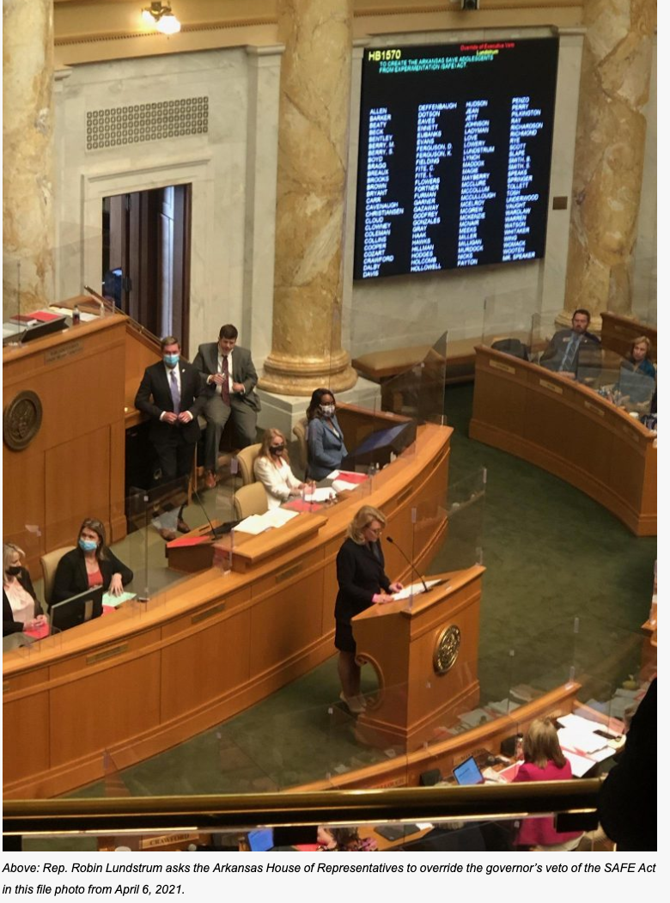
Methods of Data Collection
EBA (Emotion Belief Analysis)
Coding approach used in past ACF studies
Identifies the belief, the connected emotion, narrator and actor as expressed in discourse
80+% ICR
Legislative Testimony
2021 Hearings of HB1570
Audio testimony transcribed (otter.ai) and coded using Discourse Network Analyzer (Liefeld, 2023)
Notes:
First, we distinguish between affect and emotions, with affect defined as biologically/physiological feelings that are often ambivalent and amorphous (Mercer, 2010). We contrast that with emotions, which we define as emotional expressions of that affect expressed through language
Coaltioins identified via Girvan-Newman and Tabu
528 statements

Slide 14
Coding Emotional-Belief Expressions
Actor (Emotions ⇆ Beliefs)
Statement
“Hormone-blockers cause irreversible damage.” – Joseph Backholm, Family Research Council
Notes:
First, we distinguish between affect and emotions, with affect defined as biologically/physiological feelings that are often ambivalent and amorphous (Mercer, 2010). We contrast that with emotions, which we define as emotional expressions of that affect expressed through language
Coaltioins identified via Girvan-Newman and Tabu
528 statements

Slide 15
Coding Emotional-Belief Expressions
Actor (Emotions ⇆ Beliefs)
Code
Narrator: Joseph Backholm
Actor w/ attributed emotion: Joseph Backholm
Narrator Affiliation: Family Research Council
Narrator Position: Anti-GAC
Statement
“Hormone-blockers cause irreversible damage.” – Joseph Backholm, Family Research Council
Notes:
First, we distinguish between affect and emotions, with affect defined as biologically/physiological feelings that are often ambivalent and amorphous (Mercer, 2010). We contrast that with emotions, which we define as emotional expressions of that affect expressed through language
Coaltioins identified via Girvan-Newman and Tabu
528 statements

Slide 16
Coding Emotional-Belief Expressions
Actor (Emotions ⇆ Beliefs)
Code
Narrator: Joseph Backholm
Narrator Affiliation: Family Research Council
Narrator Position: Anti-GAC
Belief: PCB Gender Affirming Care
Emotion: damage
Emotional Category (fear)
Statement
“Hormone-blockers cause irreversible damage.” – Joseph Backholm, Family Research Council
Notes:
First, we distinguish between affect and emotions, with affect defined as biologically/physiological feelings that are often ambivalent and amorphous (Mercer, 2010). We contrast that with emotions, which we define as emotional expressions of that affect expressed through language
Coaltioins identified via Girvan-Newman and Tabu
528 statements

Slide 17
Methods of Data Analyses
Base Data 46x36 2-Mode Matrix
Identify coalitions by Girvan-Newman Algorithm (Hyp 1) (Use this to create attribute matrices)
Identify homophily of actors and dyads by Krackardt E-I Index (Hyp 2)
Convert to a 82x82 bipartite matrix
36 Emotion-Belief Dyads
46 Actors
Convert to a 46x46 matrix by correlating rows
Confirm coalitions by Tabu Search Cluster Analysis (Hyp 1)
* Coalition assignment also confirmed by manual coding of narrating actors’ positions
Create sub-matrices by belief and emotion types (e.g., 46 actors by fear-belief dyads; 46 actors by PCB-emotions dyads; etc.)
Convert to 46x46 matrices by correlating rows or taking row products
Explain same coalition assignment or similar expressions about the bill by Multiple Regression via Double-Dekker Semi-Partialling (Hyp 3)
* Confirmed by Quadratic Assignment Procedure
*All calculations done in R and/or UCINET
Notes:
Foreshadow what you will see, these are the steps on how we identify coalitions
Need to square this, both do this as bipartite
In past we didn’t present this type of slide, shares all of our steps

Slide 18
H1: Actors will coalesce into distinct coalitions by their emotion-belief expressions
Notes:
H1. Coalitions will show distinct emotion-belief expressions that remain consistent with their belief systems

Slide 19
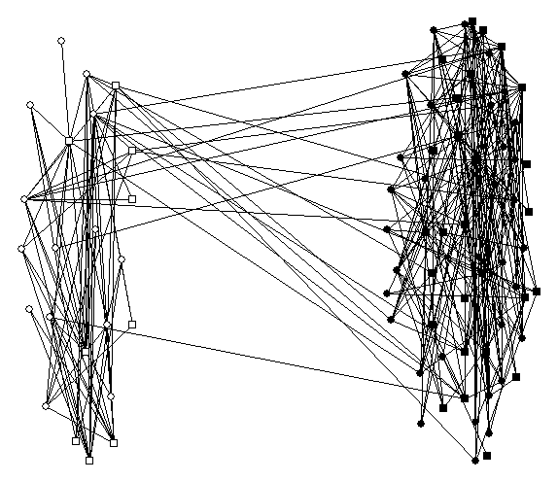
Coalition Analysis
Coalition Confirmation Analysis
Girvan-Newman Algorithm Output
1. Tabu Cluster Analysis
Tabu coalition assignment for actors matched the Girvan-Newman Algrorithm coalition assignment for 2 clusters. Three clusters subdivided the pro-GAC coalition by two sub-discourses (not the focus here)
2. Visual Assessment
The third cluster extracted one actor and one dyad as a subset of the pro-GAC coalition
Anti-GAC
Pro-GAC
Layout by Girvan-Newman 2 clusters ( = actors, ● = dyads)
Actor and dyad isolated by 3rd Girvan-Newman cluster
3. Manual Coding
Manual coding of each statement (dyad) confirms 2 clusters
Notes:
Pro are dark, white anti
Confirms hyp 1 and talk more about this

Slide 20
Comparing coalitions by discrete emotion and belief statements
Notes:
Walk you thorough our data
Total number of statements per coalition as well as how we identify beliefs (follows jenkns smith 97 coding beleifs)

Slide 21
Comparing coalitions by discrete emotion and belief statements
Notes:
Walk you thorough our data
Total number of statements per coalition as well as how we identify beliefs (follows jenkns smith 97 coding beleifs)

Slide 22
Comparing coalitions by discrete emotion and belief statements
Equity

Slide 23
Comparing coalitions by discrete emotion and belief statements
Equity
Notes:
Positive or negative and associated with PCB or SCB – these are our dyads – we have dismay + GAC

Slide 24
Comparing coalitions by discrete emotion and belief statements
Notes:
Positive or negative and associated with PCB or SCB – these are our dyads – we have dismay + GAC

Slide 25
Comparing coalitions by discrete emotion and belief statements
Notes:
Positive or negative and associated with PCB or SCB – these are our dyads – we have dismay + GAC

Slide 26
H2: Policy-Core beliefs and negative emotions will show more homophily than expressions involving deep core or positive emotions
Notes:
H2. Policy-Core belief dyads and negative emotions will show more homophily
We have different combinations of belief and emotional expressions – happy to clarify more around this organization in QA

Slide 27
Homophily analysis of belief-emotion expressions
Visual Assessment
Krackhardt E-I Index for belief-emotion expressions
(-1 = complete homophily, +1 = complete heterophily)
Anti-GAC
Pro-GAC
 | E-I Index
Deep Core Beliefs-Emotion Expressions | -0.88
Policy Core Beliefs-Emotion Expressions | -0.88
p-values | 0.52
Negative Emotion-Belief Expressions | -0.97
Positive Emotions-Belief Expressions | -0.76
p-value | 0.00
*Most ties between actors and emotion-belief dyads appear to occur within the same coalition (i.e., showing homophily)
*A standard t-test with significance based on permutation tests was used to compare means between categories to generate significance levels
Notes:
Krackhardt E-I Index (external. Internal) measure used in coalition studies to identify homophily,
The E-I Index values range from -1 to 1, with a -1 indicating complete homophily within a coalition (e.g., all statements made by an actor are directed to other actors and dyads in the same coalition as the actor’s coalition) to +1 indicating complete heterophily between coalitions (e.g., all statements made by an actor are to other actors and dyads in a coalition or all statements are made by an actor in a different coalition).
Why does it matter
Thes are high – negative 1 is means we are only internal
Our data has 57 different dyads, different combinations - - deep core / policy core
going to see which combination lead to more or less homophily
If you pull out all of the positive dyads in the matrix, along with their belief, that has the least amount of homophily (esp than negatives)
basically, within a coalition, if you have a negative feeling about the belief everyone shares it
speaks to the literature on negative emotions being more formative
We know that the two coalitions in this setting never share the same
External – internal citations,
I minuss e, divided by the sum

Slide 28
H3: Policy core belief and negative emotion expressions will be more important than deep core belief and positive emotion expressions for coalition assignment and policy position
Notes:
Coalitions’ policy core belief expressions will be more important than their deep core beliefs expressions in coalition affiliation and policy position

Slide 29
Explaining Coalition Membership and Policy Position
*Multiple Regression via Double-Dekker Semi-Partialling
Notes:
MRQAP
Standardized the coefficients so a positive coefficient indicates an increased likelihood of sharing a coalition
People with similar expressions of dismay tend to be in the same coalition
Emotion dismay is the most powerful for a coalition
MR – stack variables together, suppression can flip the sign. Look at forumulas
control for everything it doesn’t have a

Slide 30
Explaining Coalition Membership and Policy Position
 | Deep Core Beliefs | Policy Core Beliefs
Positive Emotions | Least Important | Moderately Important
Negative Emotions | Moderately Important | Most Important
*Multiple Regression via Double-Dekker Semi-Partialling

Slide 31
Hypotheses
Confirmed
H1. Actors will coalesce into distinct coalitions by their emotion-belief expressions
H2. Policy-Core beliefs and negative emotions will show more homophily than expressions involving deep core or positive emotions
H3. Policy core belief and negative emotion expressions will be more important than deep core belief and positive emotion expressions for coalition assignment and policy position
Partially Confirmed
Mostly Confirmed
Notes:
Coalitions’ Distinct Emotion-Belief Expression Hypothesis 1. Both coalitions will show distinct emotion-belief expressions and express positive and negative emotional valence and various discrete emotions in their debates consistent with their belief systems
Coalitions’ Homophily Hypothesis 2. Coalitions’ policy core belief dyads will show more homophily than deep core belief dyads, and negative emotion dyads will show more homophily than positive emotion dyads
Belief Affiliation Hypothesis 3: Coalitions’ emotion and policy core belief expressions will be more important than their emotion and deep core beliefs expressions in coalition affiliation.
Coalition’s Policy Position and Emotion-Belief Expressions Hypothesis 4. Similar emotion and policy core belief expressions will be more important for forming shared policy positions within a coalition than emotion and deep core belief expressions.

Slide 32
Key Findings
Questions
To what extent do coalitions manifest through their emotion-belief expressions in debates about Arkansas’s law (HB1570) that bans gender affirming care?
What combinations of emotion-belief expressions associate most strongly with coalition membership and similar positions on HB1570?
In debates over HB 1570 show strong coalitional patterns with high homophily in belief-emotion expressions
Beliefs about gender affirming care, dismay and fear mostly strongly associate with coalition membership and expressed policy position on HB1570
Negative emotions and policy core beliefs strongly associate with coalition membership and policy positions on HB1570
Notes:
How people feel impacts how they make sense of the world/what they believe and our theories must be able to grasp these feelings
Emotions matter in our policies, our politics, and studies thereof

Slide 33
Thank you!
Allegra.Fullerton@ucdenver.edu
@allegra_fuller
Chris.Weible@ucdenver.edu
@chris_weible
@policy_democracy

Slide 34
Anger | Emotion words indicate feelings of discontent and antagonism. This category includes emotion words such as: anger, frustration, ire, “fed up,” affront, blame, blasted, chafed, defy, enrage, heated, and resentment.
Affinity | Emotion words indicate feelings of support or wanting someone/something. This category includes emotion words such as: acceptance, admiration, agree, approve, applaud, desire, praise, respect, support, and thank.
Careless | Emotion words indicate either an apathy for someone/something or state of disregard for the emotions of others. This category includes emotion words such as: apathy, careless, “don’t care,” disregard, selfish, uncaring, and unconcerned.
Compassion | Emotion words indicate positive feelings towards another person or towards oneself with an association of protecting that person from harm or suffering. This category includes emotion words such as: care, brave, connection, courage, defended, love, protect, solidarity, “stand with,” understand, and united.
Dismay | Emotion words indicate negative feelings held by an actor about another person, their actions, or something (e.g. a policy). This category includes emotion words such as: condemned, criticism, denial, disagree, disappoint, disgraceful, disgust, and dislike.
Fear | Emotion words indicate negative feelings associated with a danger or threat. This category includes emotion words such as: afraid, anxiety, concern, dire, dread, frightened, nerve-wracking, panic, risk, terror, unsafe, and worry.
Trust | Emotion words indicate feelings of confidence or trust of someone/something. This category includes emotion words such as: believe, certainty, commit, confidence, conviction, determination, justified, know, pride, safe, and trust.

Slide 36
Anti or Pro ascribers of emotional statements to allies or opponents

